Slide 1
8- Lambda Functions

Slide 2
Lambda Expression or Lambda function
a simple one line,
anonymous function
that we can pass to other functions.
this is a shorter and cleaner way to define a function
that we're going to use only once,
as an argument to another function

Slide 3
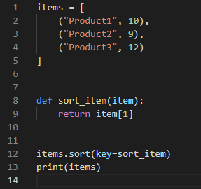
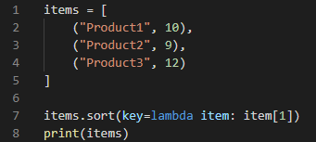
Ex.1

